Slide 1
Writing a formal letter
Ivan zavaruev
Pi19-1v

Slide 2
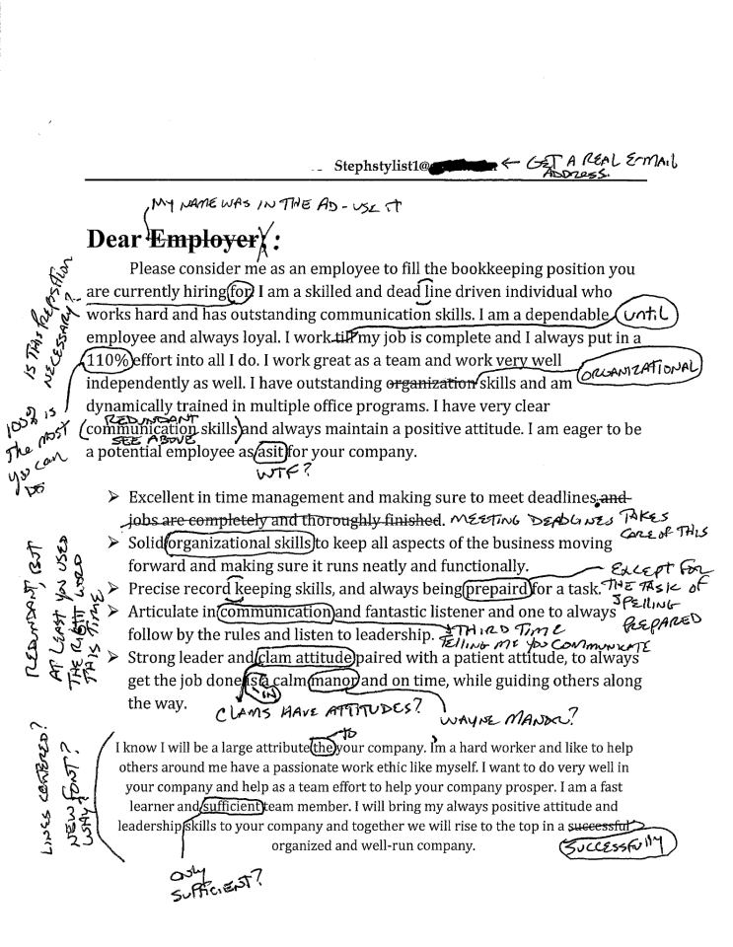
Two rules:
Simply
Clear

Slide 3
Addresses
Date
Your address
The address of the person you are writing to
Just throw it somewhere

Slide 4
Salutation
Ending
Dear Sir or Madam
Dear Mr Jenkins
Yours Faithfully If you do not know the name.
Yours Sincerely If you know the name
Your signature

Slide 5
